Slide 1
CST 238 – GUI Programming
Lecture #6
Visual Design and Layout

Slide 2
Why bother?
Using guidelines is important because:
Guidelines are based on usability heuristics
Consistency is key for a large and diverse product
Details are noticed by the customer

Slide 3
Guideline sources
Windows (or other OS) interface guidelines
General usability standards
Product-specific or company-specific design standards
Internationalization requirements
LOTS of books on the market

Slide 4
Usability - consistency
Follow standards for controls
Consistent behavior and aesthetics
Clean, logical layout
Understandable and relevant images and icons
Clear and consistent terminology

Slide 5
Usability - feedback
Cursor shape (for modes, drag-n-drop)
Grayed/disabled fields
Cursor motion, change of focus or window
Message and progress dialogs
Status bar, tooltips, window titles
View decorations - axes, icons, messages
2D/3D “predictive” rendering
Highlighted text, selection boxes

Slide 6
Usability - navigation
Follow the natural flow of work
Name the dialogs to help trace the path
No more than 3-4 levels deep
Supply alternates - toolbars or shortcuts
Provide keyboard navigation within a dialog
Use cursors, status bar messages to prompt for next action
Context menus

Slide 7
Usability - frequent tasks
Logical menu order, appropriate nesting
Toolbars for frequently used commands
Shortcuts for heavily used commands
Reasonable defaults, initial focus
Persist settings and data
Automate data capture
Avoid excessive message dialogs
Understand the user’s process

Slide 8
Usability - forgive mistakes
Anticipate them and try to compensate
Show examples or valid ranges
Esc to cancel
Give helpful error messages
Confirm destructive actions
Undo and redo
Periodic saves

Slide 9
UI Design (windows)

Slide 10
Window types
Primary windows
Document windows
Secondary windows
Task dialogs
Property sheet dialogs
Message dialogs

Slide 11
Window attributes
Frame
Title bar and title
Window menu
Sizable or not?
Modal or not?
Movable or not?
Recreated each time, or reused?
Relationship to parent window

Slide 12
Primary windows
Main window in the application
Contains a title bar (with icon) and frame
Can be moved, sized, minimized, maximized
Generally has a menu bar, toolbar/docking area(s), status bar, and document viewing area
Appears on the task bar
Parent of all other application windows

Slide 13
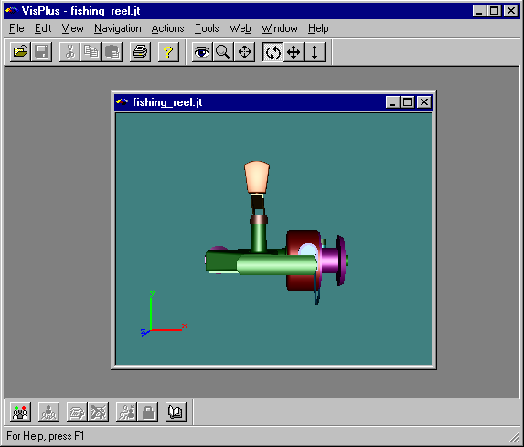
Window title bar
Menu bar
Toolbar/docking areas
Document viewing area
Status bar

Slide 14
Document windows
Contained in the viewing area of a MDI (multiple document interface) application
Represents a view into a document, can have multiple views of the same document
Can be moved, sized, minimized, maximized, within the primary window’s viewing area
Contains a title bar (with icon) and frame
Can contain frame decorations

Slide 15
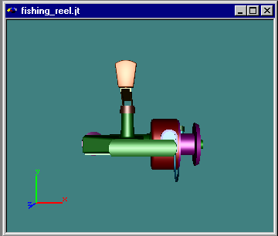
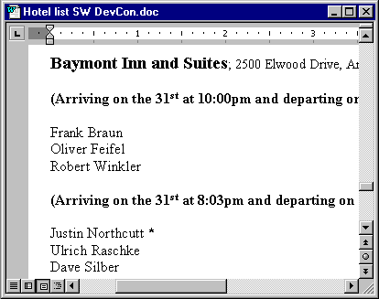
Frame decorations

Slide 16
Secondary windows
Displays supplemental information
Floats over/outside the main window, or can be docked inside - never modal
Usually not maximized/minimized
May be sizable (especially for docking ones)
Contains a title bar and frame
No title bar icon, no menu, no status bar
Can include “what’s this” help button

Slide 17
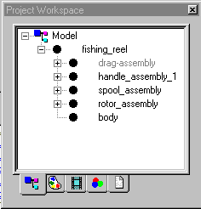
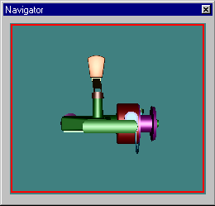

Slide 18
Task dialogs
Temporary - helps the user to do a task
Generally tied to the current document
Usually modal
Should be reused instead of recreated (to persist location and settings)
Can expand (only for tightly coupled info)
Can cascade (not more than 3 levels)
Not sizeable

Slide 19
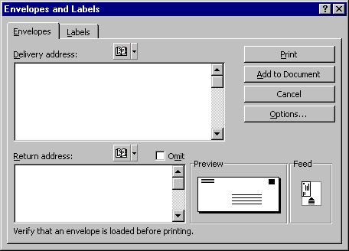
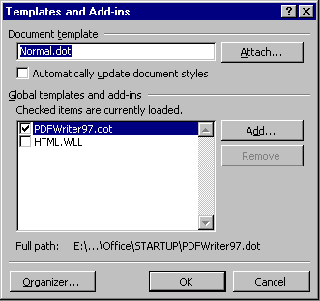
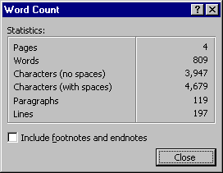
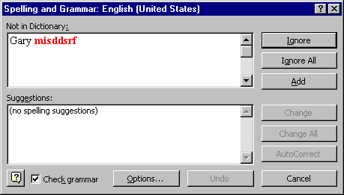

Slide 20
Modal vs. Modeless
Modal
  much easier to program
  user must close window before proceeding
  restricts the user’s workflow
  useful for finite tasks
  have reasonable defaults so the user can just hit “enter” to continue

Slide 21
Modal vs. Modeless
Modeless (aka non-modal)
  window stays open while user interacts with other windows in the application
  more flexible work flow
  useful for ongoing processes
  much harder to program (have to dynamically update if data can change)
  more complex to test

Slide 22
Property sheet dialogs
Any object can have properties/preferences
Title bar identifies the object
Single object (easier) or multiple (harder)
Uses a tabbed page
Usually modal, with “apply” to view changes
Button location is important (inside or outside the tab area)
Not sizeable, should be reused

Slide 23
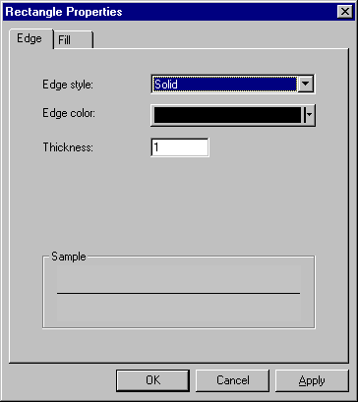
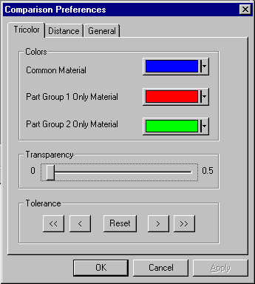

Slide 24
Message dialogs
Gives feedback to the user
Info (not modal)
Warning/Question (modal)
Error (modal)
Progress (modal or not)
All are movable, but should not remember location
Use complete sentences

Slide 25
Info dialogs
Informs the user of some important status (such as completion of a long task)
Use very sparingly (can interrupt the user)
Contains one button: “OK”
Almost always modeless

Slide 26
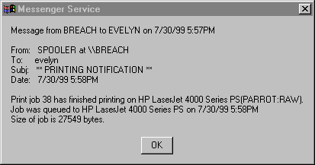
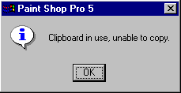

Slide 27
Warning/question dialogs
Warns the user of a potentially destructive action, and gives the user some options
Contains either 2 or 3 buttons: (OK, Cancel or Yes, No) or (Yes, No, Cancel) - 3 is better
Make sure the question is clear, and the buttons answer the question.
The default button is the least destructive
Always modal

Slide 28
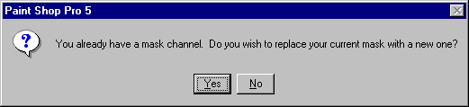

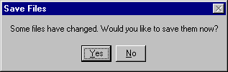
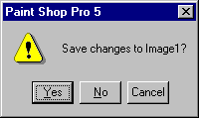
Two choices okay...
Two choices bad…
(needs Cancel)

Slide 29
Error dialogs
Informs the user of an error they have made
Contains one button: “OK”
Always modal
Gently and clearly explain the error, and suggest how the user can fix it.
If there is a logical fix/undo, just offer to do it (question dialog)

Slide 30
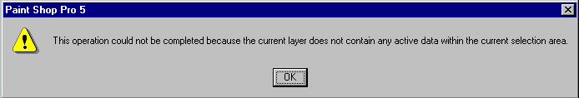
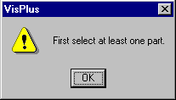
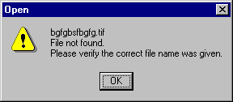
A little too wordy and unclear...
A little too terse...
Just about right!

Slide 31
Progress dialogs
Shows progress for waits
Give useful information: time remaining, elapsed time, or step in the process
Allow user to pause and/or cancel the operation if possible
If wait is <6 sec, a cursor change is enough
Can be modal or modeless
Automatically dismiss when done

Slide 32
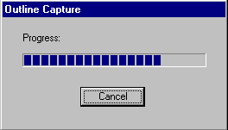
Would be better with more status information
(“Model 2 of 5” or “3 models remaining”),
or a time estimate if it can be calculated.

Slide 33
UI Design (controls)

Slide 34
Menus
Pull-down (main) menus
  access to all functions
Toolbars
  most frequently used menu functions
Context (pop-up) menus
  item-specific functions
  transfer functions (cut/copy/paste)
  important general functions
  apply to all selected objects, whenever possible

Slide 35
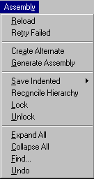
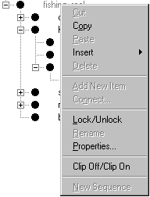

Toolbar
Main menu
Context menu

Slide 36
Menus, cont.
Group related commands, put separators between the groups
Order according to frequency of use
Use cascading menus to hide complexity - no more than 3 levels, 2 is much better
Use single words for menu titles
Keep item text brief and clear
Use book capitalization and an active syntax

Slide 37
Menus, cont.
Use mnemonics and status bar help for each menu item
Use accelerators/shortcuts for key items (not for popup menus) and include in item label
Disable non-applicable entries
Use ellipses (…) for “more info” items
Use checks/dots for toggles/radios
Use icons in the menus – IF you can do so consistently

Slide 38
Labels / static text
Use to identify other controls, or give extra information
Strive for brief, clear text
Use “:” at the end of labels to show connection to associated control(s)
Use sentence capitalization
Left-justify and align on the left for easier reading
Put mnemonics on the label if the associated control does not have text

Slide 39
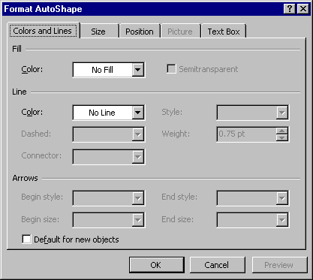
Static text labels:
Notice the associations, mnemonics, alignment, and capitalization.

Slide 40
Pushbuttons
Use for major actions in a dialog
Choose clear and concise text
Use consistent labels and industry standards
Consider replacing OK with a specific term (like “Print”), especially if it will bring up another dialog
Use title capitalization, center justification
Use mnemonics, except for OK & Cancel (which use Enter and Esc)
Limit to ~6 per window

Slide 41
Pushbuttons - layout
All buttons should be the same size, or one of two sizes
Group standard buttons (OK, Apply, Cancel), and then other functional buttons
Separate the groups with white space and place at top right or bottom right (not both in the same dialog), depending on layout
Place domain-specific buttons near the domain rather than at the bottom, align them to the other controls

Slide 42
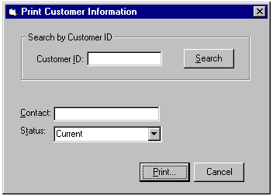
Pushbuttons:
Okay to use specific words instead of OK/Cancel. Notice the use of mnemonics and the placement of the domain-specific button.

Slide 43
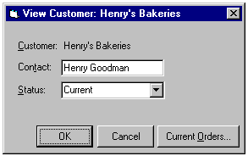
Pushbuttons:
Notice the button sizes and the capitalization.

Slide 44
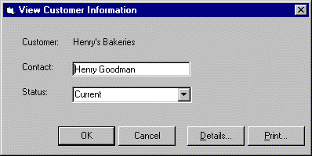
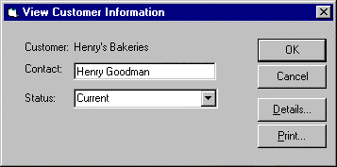
Pushbuttons:
Notice the groupings and the placement.

Slide 45

Pushbuttons - variations
Use ellipses (…) for actions which bring up dialogs that ask the user for more information
Use chevrons (>>) for “advanced” functions (only for tightly coupled information) and remember to allow for reverse action (<<)
You can also add icons, but only if they are used consistently throughout the application (in menus and toolbars, etc.)

Slide 46
Check boxes
AKA: toggle buttons
Use for independent “on/off” choices
Can also activate/deactivate other associated controls
Can also use to label associated controls (include “:”)
Can use a “mixed” state for multiple objects

Slide 47
Check boxes
Avoid double negatives
Use sentence capitalization and left justification
Set to most logical initial state
Group them logically
Maximum of six in a group
Vertical orientation is best

Slide 48
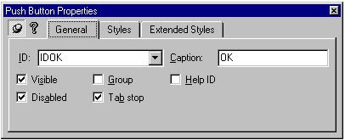
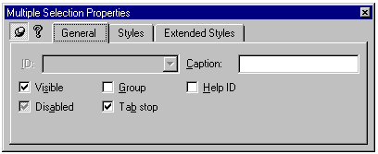
One object
Multiple objects
Check boxes:
Notice alignment, mnemonics, capitalization, use of “mixed” state.

Slide 49
Radio buttons
AKA: option buttons
Use for one-of-many choices
Can also activate/deactivate other controls
Can label associated controls (include “:”)
Group them with a labeled group box
Max six in a group (use list box for more, or for a variable number)
Avoid using for yes/no or on/off choices (use checkbox instead)

Slide 50
Radio buttons - layout
Use sentence capitalization and left justification
Vertical orientation is best
Most logical choice is selected as default
Choose an order
  by frequency of use
  by task
  by logic
  by alphabet (note that localization may change this ordering)

Slide 51
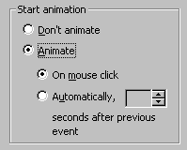
Radio buttons:
Notice alignment, mnemonics, capitalization, nesting effect. Should “Animate” have been a checkbox?

Slide 52
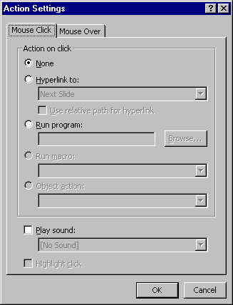
Radio buttons:
Notice the use as labels, and the logical ordering.

Slide 53
Toolbar buttons
Use for actions and for check/radio behavior
Use 16-color, 16x16 pixel images
Design all your icons as a cohesive group, following the application style
Add tooltips to match the menu items exactly
Add status bar messages which truly give more information - don’t just paraphrase the tooltip!

Slide 54
List boxes
Use for variable choices
Best for dynamic data (unknown quantity)
Several types:
  standard (choices shown, can have multiple select)
  drop-down (only current selection is shown)
  drop-down combo (lets user type also)
  summary (for long multiple select lists, to show what is selected)

Slide 55
Entry fields
Use for value input or modification
Avoid scrolling when possible
Show state: editable (white) or not (gray)
Always use with a text label, and put the mnemonic on the label
Use spinners rarely - only if the domain is known and small

Slide 56
Entry fields
Add buttons as helpers (search, calendar…) if possible
Use a static text control to give examples if format is important
Left-justify regular text, right-justify numerical values

Slide 57
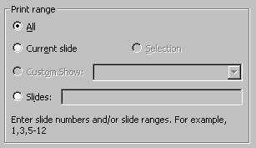
Entry fields:
Give an example if format is important.

Slide 58
Sliders
Used to supply a wide range of values
Almost always include a corresponding entry field control to show the value and allow direct editing (use appropriate precision)
Label the “ends” if this will help users understand the range
Include units label if needed
Apply range limits when appropriate

Slide 59
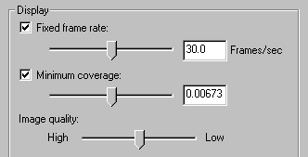
Sliders:
Notice the mixed use of precision, entry fields and labeling of the endpoints. The range of the second slider is 0-1, logarithmic - is this a good idea?

Slide 60
Group Boxes
Use to add organization
Make sure all content relates to the label
Use sentence capitalization, no colon
Do not treat like a checkbox or radio button
Avoid nesting, avoid using for only 1 control
Add a mnemonic if it makes sense that the first control does not have its own label

Slide 61
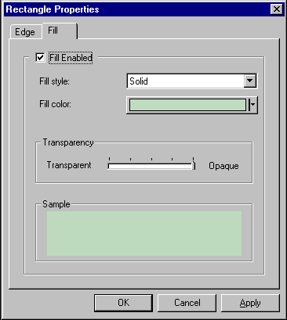
Group boxes:
Ummmm….. This could use some work.

Slide 62
Graphical Elements
Icons (toolbars and elsewhere)
  consistent style
  not just gratuitous
  clearly understood image
  no text or letters in the image (not localizable)
  for a group of icons: aim for functional groupings, and use common graphical elements to tie them together

Slide 63
Graphical Elements
Colors
  use to add meaning, organization, emphasis
  take advantage of standard meanings (red=hot, blue=cold, etc.)
  use a max of 5 colors for coding
  limit the use of colors in icons and custom controls - less is more
  use standard 4-bit (16 color) palette
  avoid multiple shades of red & green
  intensity contrast is most important for legibility

Slide 64
Column heading (table)
Use for report-type data
Columns should be sizeable
Columns should be sortable if it makes sense for your data
Can use icons to help visually identify items
Use clear column titles (sentence caps)
Use appropriate alignment (left for text, right for quantites)
Allow for searching if appropriate

Slide 65
Tree view
Specialized list box which shows hierarchical relationships
Include buttons to allow collapse/expand
Include icons to show data type, if appropriate
Avoid using for non-hierarchical information
Avoid multiple select if at all possible

Slide 66
Other custom controls
Grid
  use to present spreadsheet or 2D spatial data
  allow for navigation (scrolling, zooming, etc.)
  carefully design the data interaction (picking, dragging, deleting, etc.)
GANT Chart
  use to present time-dependent data
  allow for navigation (scrolling, zooming, etc.)
  carefully design the interaction

Slide 67
Dialog layout
Choose an orientation (horizontal or vertical) that fits the content
Follow guidelines for text capitalization, punctuation and syntax
Follow guidelines for text justification
Group controls according to task sequence
Place most important controls in upper left
Use white space to emphasize relationships

Slide 68
Dialog layout
Controls should never touch window borders or each other
Align text controls along the left
Use consistent widths for entry fields
Align radio buttons and checkboxes vertically
Indent dependent controls
Align group boxes along borders
Minimize alignment points

Slide 69
Alternative input
Specify unique mnemonics for all menu items
Specify unique mnemonics for all active controls in a dialog, as much as possible
Define a dialog’s tab sequence to allow cycling through all active controls
Create shortcuts (delete, arrow keys, etc.)
Provide standard hotkeys for common commands (open, save, etc.) and other heavily used commands

Slide 70
UI Design (miscellaneous)

Slide 71
View window interaction
2D object manipulation
  creation
  selection, multiple selection
  sizing - free and constrained
  moving
  alignment
  grouping
  layering

Slide 72
View window interaction
3D object manipulation
  selection, multiple selection
  transformation
  alignment
  creation of 3D “support” entities (paths, coordinate systems, reference planes, section planes, etc.)

Slide 73
User Assistance
Full on-line help
“What’s this?” help
Tooltips
Status bar feedback
Wizards
  design a good UI first, then add wizards

Slide 74
Internationalization
Avoid locale-specific design (layouts and icons)
Leave extra room (30-50%) in textual controls
Put all static text in resource files (do not hard-code any static text), add “_DNL” to the end of string IDs for strings which should not be translated
Use special library routines for dynamic text

